Slide 1

GraalVM Native Images With Java 17
Paul G. Allen, MSSE

Slide 2
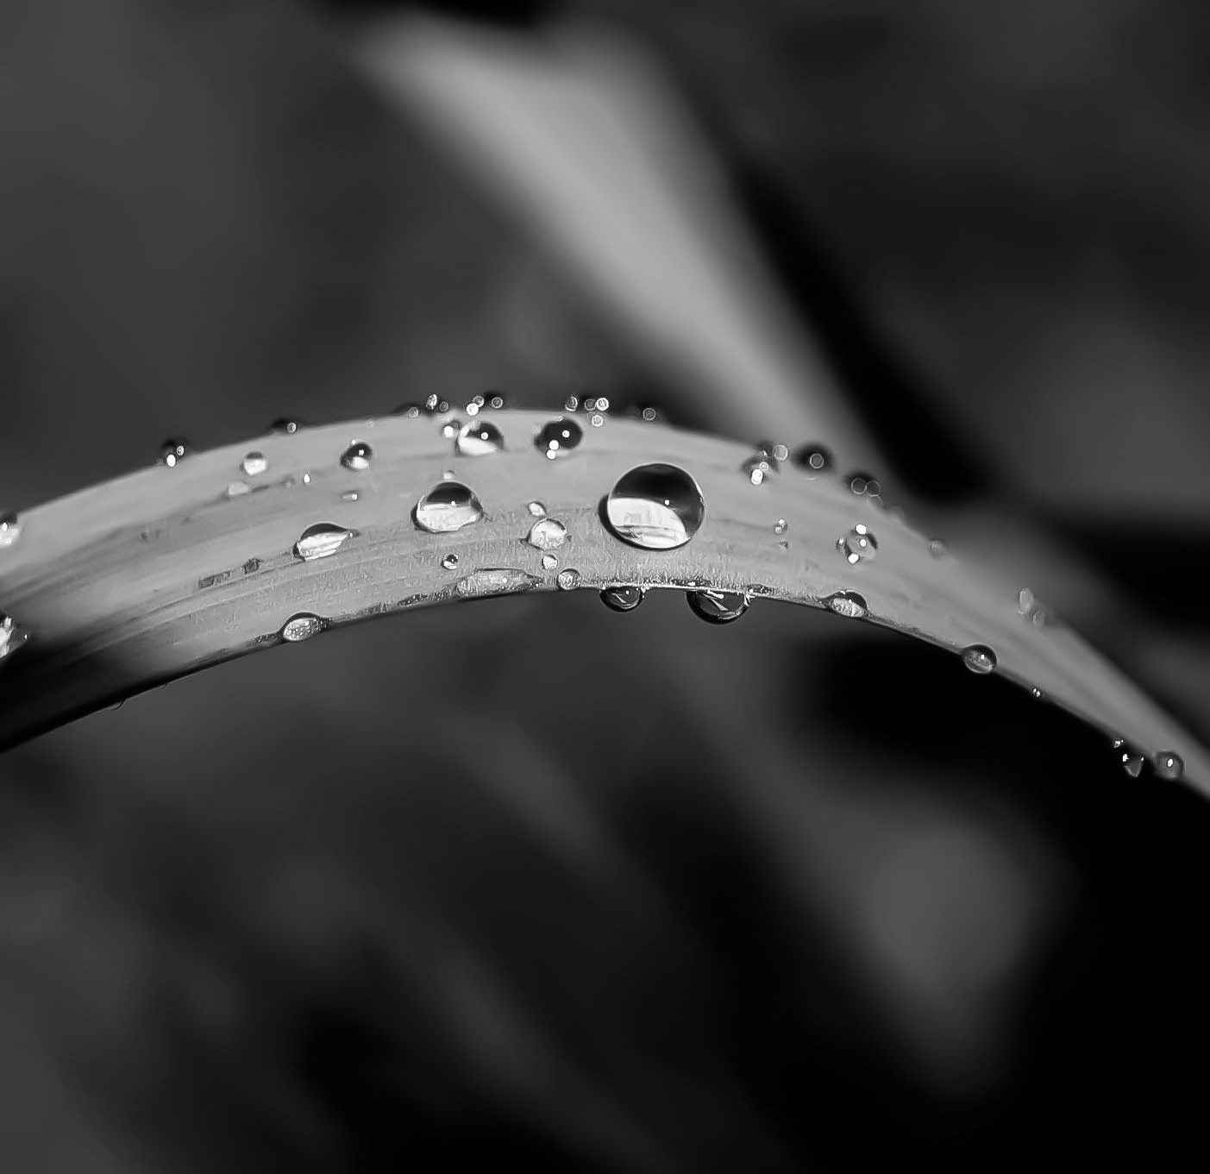
Contents
Introduction
Java 17 Overview
GraalVm Overview
Native Images
Process
Native Image Conversion
References

Slide 3
Introduction

Slide 4
Introduction
Author
SW Engineer for more than 30+ years (commercial, contractor)
Java Engineer for 15+ years (commercial, contractor)
HW engineer for 10+ years (commercial, contractor)
Systems Engineer for 10+ years (commercial, contractor)
UNIX Administrator for 10+ years (commercial, contractor)
Cybersecurity since before it was a term (commercial, contractor)
Working with Oracle Technologies for 5 years (Java, WebLogic, oracle DB)
Working with cloud for 2 years (Azure, private cloud)
Working with containers for 1 year (Docker, Kubernetes)
Oracle sponsored Java 17 webinar including focus on GraalVM in 2021

Slide 5
Introduction (Cont)
Technology
The “Cloud” has taken a hold on the industry
The cloud and high-speed internet enabled microservices
Containers enabled better microservice management
Microservices caused resource usage to explode
These technology changes increased security risks
Solutions were needed
Java 17 tightens security and improves performance
GraalVM further tightens security and improves performance

Slide 6
Java 17 Overview

Slide 7
Java 17 Overview
Relevant Features
Container Aware
New Garbage Collectors
Security Improvements
1%-8% Faster Code Execution
CDS Archive Changes for Faster JVM Startup
Improved GraalVM Compiler

Slide 8
Java 17 Overview (Cont)
JEP Implementations
JEP 353: Reimplement the Legacy Socket API
*JEP 372: Remove the Nashorn JavaScript Engine
JEP 396: Strongly Encapsulate JDK Internals by Default
JEP 403: Strongly Encapsulate JDK Internals
*JEP 411: Deprecate the Security Manager for Removal
Garbage Collectors
G1 (default, reduced pause times)
ZGC (even lower pause times)
Shenandoah (pause time independent of heap size)
No-Op (memory profiling)

Slide 9
GraalVM Overview

Slide 10
GraalVM Overview
Creation
Oracle Labs team in Switzerland and Austria
Lead by Thomas Wuerthinger
Ten (10) years in development
Written in Java and supporting any program in any language
Community Edition and Enterprise Edition
Enhanced security and performance

Slide 11
GraalVM Overview (Cont)
Technology
Written in Java
Easier for developers to modify
Memory-safe
benefits from Java profiling and debug tools
Polyglot
Java
JavaScript (Node.js)
LLVM (C and C++)
Python
R
Ruby
WASM
Specific language or polyglot (JS, Ruby, R)
Truffle

Slide 12
GraalVM Overview (Cont)
Technology (Cont)
Native Image
No JVM
Native machine language
Fast startup, fast execution, smaller footprint
Compiler
AOT Compiler
JIT Compiler

Slide 13
GraalVM Overview (Cont)
Features/Enhancements
Up to 100 times faster startup
Eliminates the virtual machine (JVM)
Applications need not be in an idle state
Less memory
No JVM == smaller footprint
No JVM == fewer computational resources used
Native image

Slide 14
Native Images

Slide 15
Native Images
What is it?
Compiled into target’s machine language
No JVM
Features
No JVM == smaller memory footprint
No JVM vulnerabilities (e.g. – no vulnerable String types)
Machine language == faster sustained performance

Slide 16
Native Images (Cont)
Pros
Few resources needed
More secure
Better container support
30% - 50% better performance
Up to 90% smaller images
Cons
Breaks the “Write once, run anywhere” mantra
Longer compile time
More complex build process
No run-time optimization
No JVM

Slide 17
Process Overview

Slide 18
Process Overview
Java 17 Upgrade
Baseline
Build and test stable release
Unit tests
Full regression test if needed
Update to Java 17
Update JDK
Compile
Address failures
Repeat 2B
Test
Unit test
Regression test
Repeat from 2B as needed
Stable Java 17 Complete

Slide 19
Process Overview
Create Native Image
Full test with tracing agent
Unit test if possible
Regression test
Manual test
Build native image
Build non-container image
Address failures
Repeat Java 17 build Step 2B

Slide 20
Process Overview
Test Native Image
Unit test if possible
Regression test
Manual test
Complete Stable Native Image
Create Docker Image
Two stage or single stage image build?
Two stage for different target architecture
Single stage if same target architecture
System Test container

Slide 21
Native Image Conversion

Slide 22
References

Slide 23
References
Forbes: Meet the Team that Built GraalVM, an Energy-Saving Multi-Lingual Compiler Written Entirely in Java
GraalVM
OpenJDK JEP Index
Java 17 Features: A comparison between versions 8 and 17. What has changed over the years?

